Slide 1
Why Is Information Security Needed ?
Bangladesh Bank SWIFT Hack – Feb 2016: Hackers used SWIFT credentials of Bangladesh Central Bank employees to send more than three dozen fraudulent money transfer requests
REF: WIRED.COM

Slide 2
Why Is Information Security Needed ?
Contd…
Requests sent to the Federal Reserve Bank of New York asking the bank to transfer millions of the Bangladesh Bank’s funds to bank accounts in the Philippines, Sri Lanka and other parts of Asia.
USD 81 million stolen
Total impact could have been USD 1 billion
REF: WIRED.COM

Slide 3
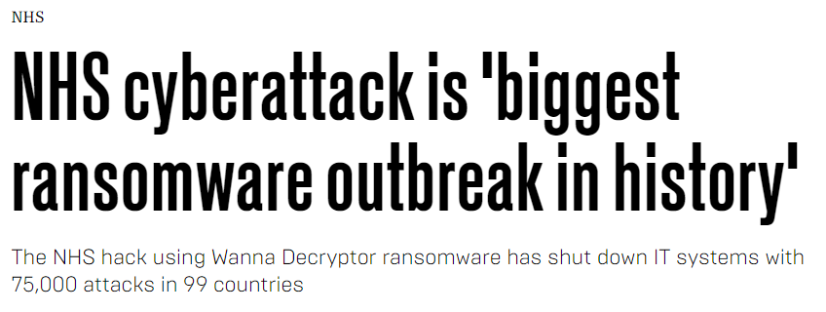
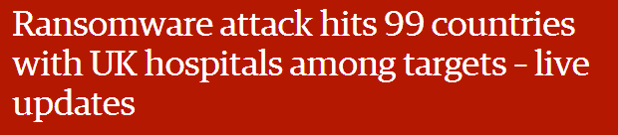
Why Is Information Security Needed ?
Recent Cyber Attack – May 2017
REF: TELEGRAPH

Slide 4
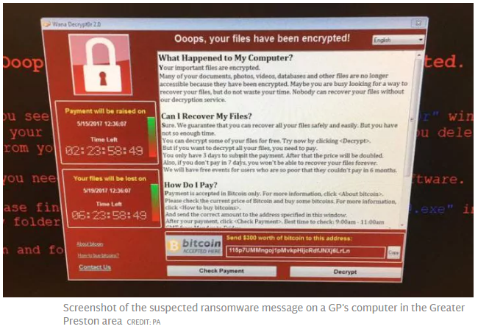
Why Is Information Security Needed ?
REF: GUARDIAN

Slide 5
Why Is Information Security Needed ?
The Importance Of Information
IT is pervasive in our society & critical to the Ops & Mngmt of all organizations
IT is an enabler for business and govt
Personal information is vital for individuals to function in society
Information holds value

Slide 6
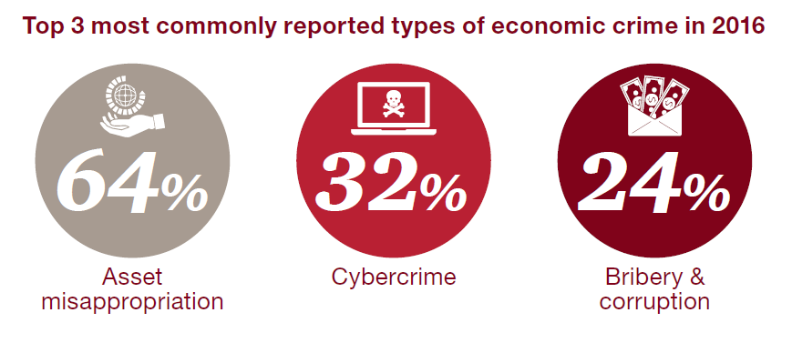

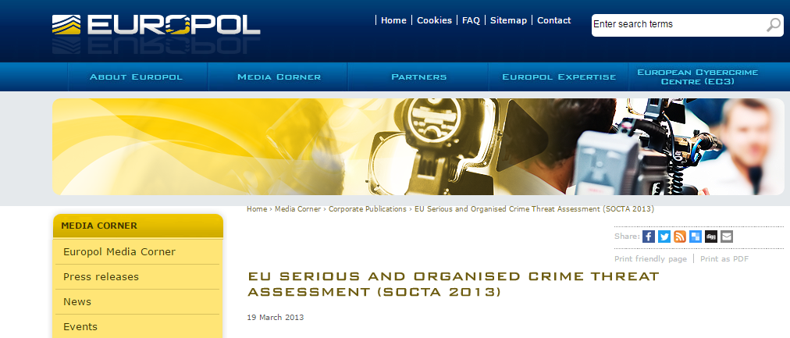

Why Is Information Security Needed ?
IMPORTANCE OF INFORMATION SECURITY
As per PWC Global Economic Crime Report 2016, Cyber Crime was amongst the top 3 most commonly reported types of economic crime
As per Europol 2013 report, Cyber Crime is now more profitable than the drug trade

